Slide 1

Generating S&P 500 Futures with Machine Learning
Maurice Roots
DATA 602: Term Project (12/14/2021)
Motivation
Investment Journey
Dataset Selection
Background
Exploratory Data Analysis
Model Performance
Support Vector Machines (SVM)
K-Nearest Neighbors (KNN)
Random Forests (RF)
Ensemble Models
Summary

Slide 2
Technical Analysis
ML Account Manager
Stock Picking
Robinhood
Investment Accounts
Trading & Strategies Accounts
2018
2019
2020
2021
2022
Intra-Year Trading
Algorithm Trading Bot
Retirement Accounts
1
Motivation: Investment Journey

Slide 3
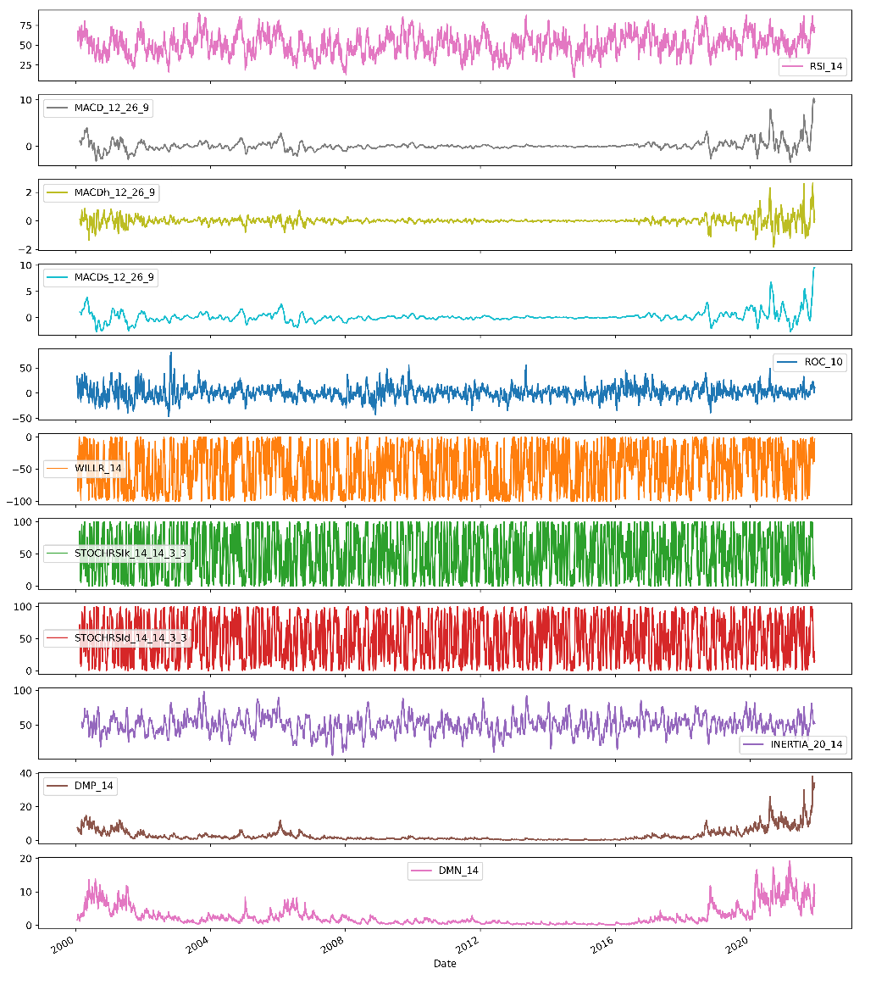
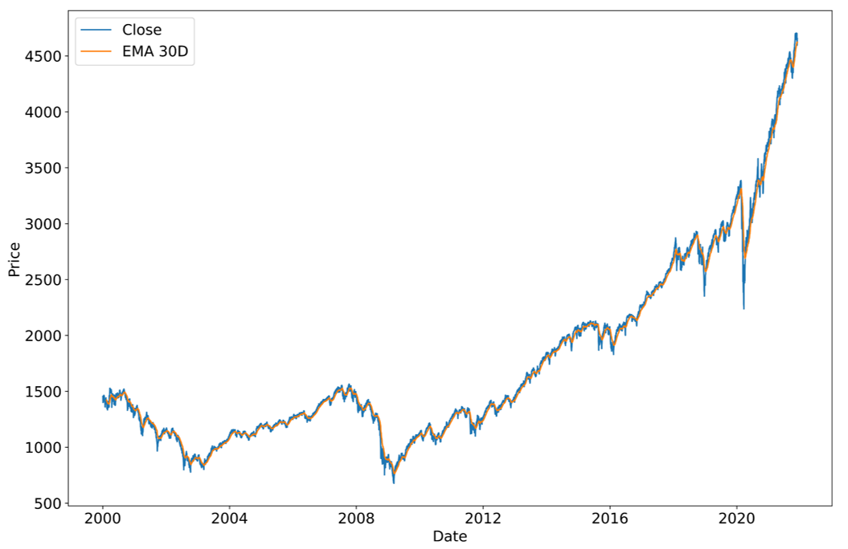
Hypothesis:
An ensemble model trained on handpicked momentum indicators from selective stocks, indices, and commodities futures may yield sufficient results in predicting S&P 500 futures.
S&P 500 (^GSPC)
Price has too much noise!
Its not repeatable
Varying Scales
Momentum Oscillators
Repeatable!
Scaled!
2
Motivation: Dataset Selection

Slide 4
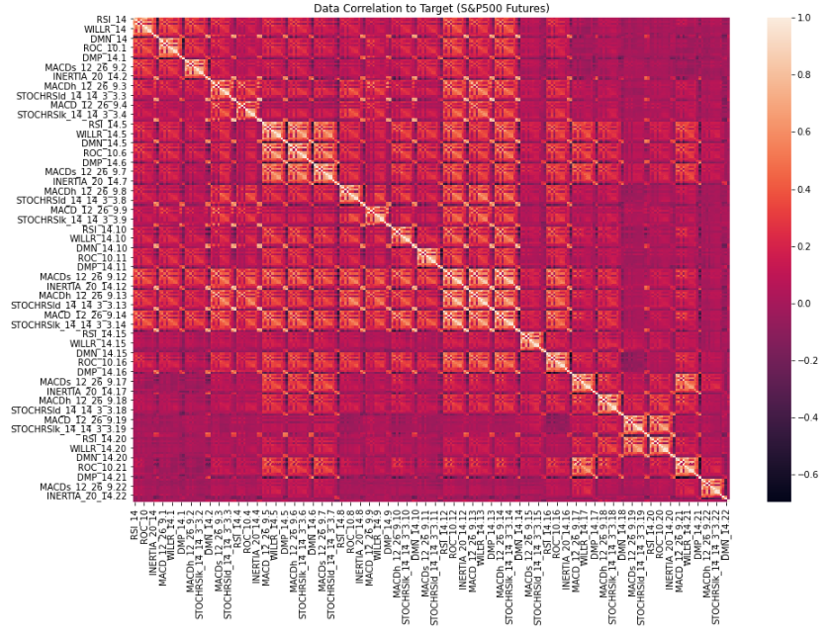
No Multi-collinearity!
Low Correlations
253 features
Ignore the names as the repeat.
The Target feature is the last column, and row
Built using pandas-ta
3
Background: EDA

Slide 5
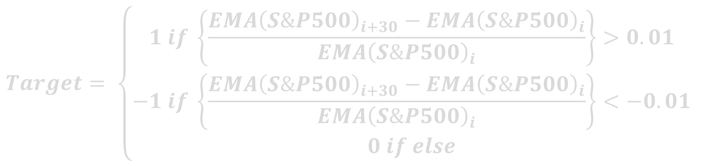
$$Target= \left\{\begin{aligned}1 if \left\{\frac{EMA{\left(S\&P500\right)}_{i+30}−EMA{\left(S\&P500\right)}_{i}}{EMA{\left(S\&P500\right)}_{i}}\right\}>0.01 \\ −1 if \left\{\frac{EMA{\left(S\&P500\right)}_{i+30}−EMA{\left(S\&P500\right)}_{i}}{EMA{\left(S\&P500\right)}_{i}}\right\}<−0.01 \\ 0 if else\end{aligned}\right.$$
EMA is smooth!
3 Classes [-1, 0, 1]
10% Tolerance build in!
4
Background: Target Building

Slide 6
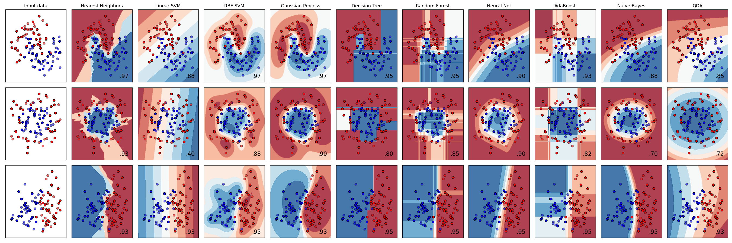
Models Evaluated
https://scikit-learn.org/stable/auto_examples/classification/plot_classifier_comparison.html#sphx-glr-auto-examples-classification-plot-classifier-comparison-py
5
Background: Choosing the Model

Slide 7
Best Estimators
https://scikit-learn.org/stable/auto_examples/classification/plot_classifier_comparison.html#sphx-glr-auto-examples-classification-plot-classifier-comparison-py
5
Background: Choosing the Model

Slide 8
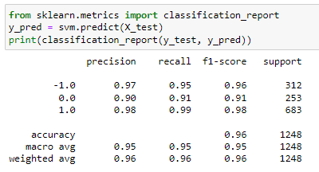
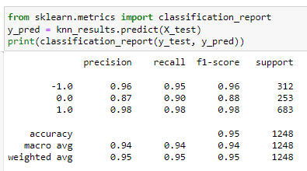
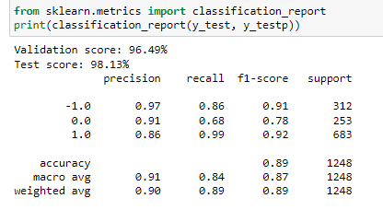
Support Vector Machine Classifier (SVC)
RBF Scored 98% on training
4-Nearest Neighbors (KNN)
Scored 99% on training
Random Forest (RF)
PCA: 20, Depth: 20
Scored 96% on training
6
Model Performance: SVM

Slide 9
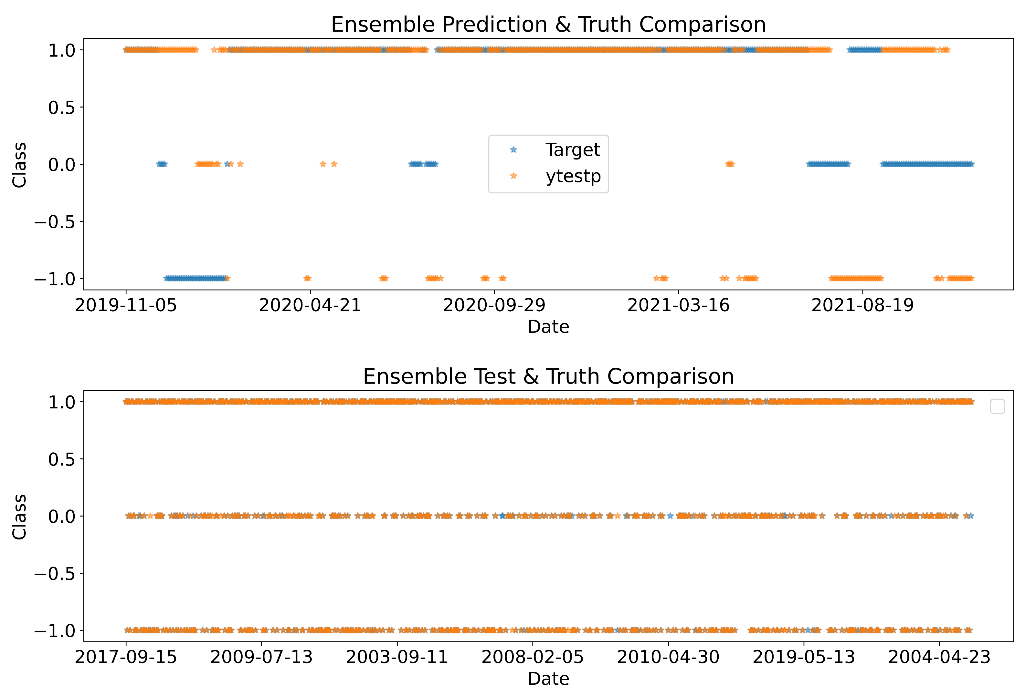
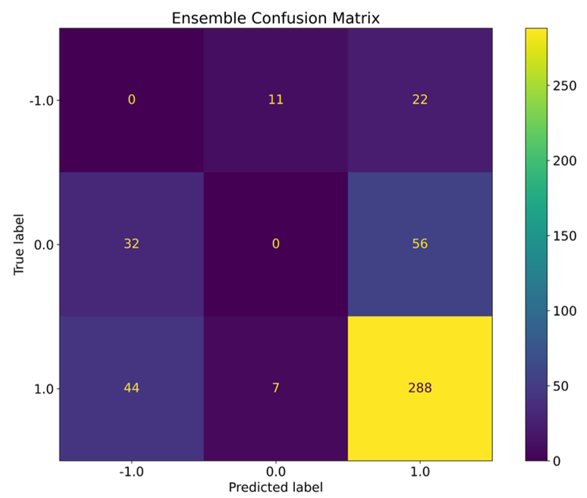
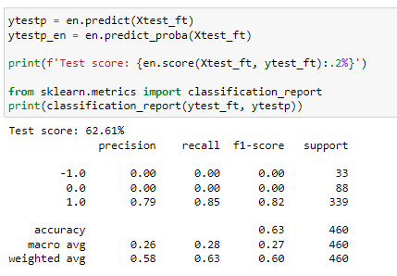
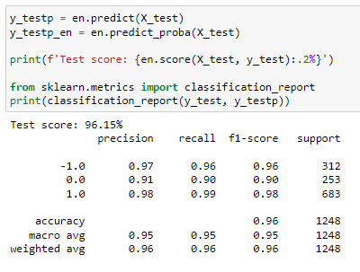
The Ensemble seem pretty good at predicting increases in S&P500. Not surprising since the past year has been increasing.
Testing on the “Past” Data was excellent at 96% while the test on “prediction” data was at 62%. Better than a coin toss!
7
Model Performance: Ensemble

Slide 10
A Soft Voting Ensemble Classification model comprised of an SVM, KNN, and RF was created to generate S&P 500 futures using handpicked! 62% of last few years.
Better than a coin toss!
Simple Implementation!
Excellent Learning Experience!
Next Steps!!!
Needs more tuning on Dataset & Models...
Needs another thorough look through...
Conversion into something deployable
Train for 14-Day and 7-Day forecasts
8
Summary

